Slide 1
Module 6
Services and Dependency Injection

Slide 2
What is a Service
A service is typically a class with a narrow, well-defined purpose. It should do something specific and do it well.
Angular distinguishes components from services to increase modularity and reusability
Angular services are singleton objects which get instantiated only once during the lifetime of an application.
export class Logger {
log(msg: any) { console.log(msg); }
error(msg: any) { console.error(msg); }
warn(msg: any) { console.warn(msg); }
}

Slide 3
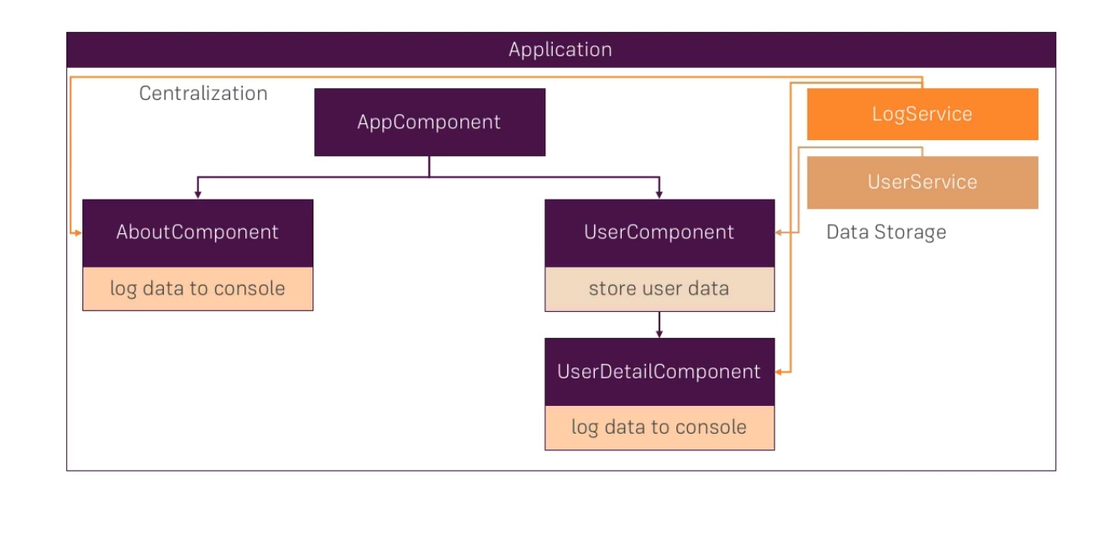
What are Services

Slide 4
Dependency Injection
Dependencies are services or objects that a class needs to perform its function. DI is a coding pattern in which a class asks for dependencies from external sources rather than creating them itself.
DI is wired into the Angular framework and used everywhere to provide new components with the services or other things they need.

Slide 5
Hierachical Injector
Components consume services; that is, you can inject a service into a component, giving the component access to that service class.
The injector is responsible for creating service instances and injecting them into classes
Angular creates injectors for you as it executes the app, starting with the root injector that it creates during the bootstrap process.

Slide 6
Providers
A provider tells an injector how to create the service. You must configure an injector with a provider before that injector can create a service
A provider can be the service class itself, so that the injector can use new to create an instance.

Slide 7
Injecting a service
constructor(recipeService: RecipeService)

Slide 8
Tokens
When you configure an injector with a provider, you associate that provider with a DI token. The injector maintains an internal token-provider map that it references when asked for a dependency. The token is the key to the map.
In simple examples, the dependency value is an instance, and the class type serves as its own lookup key. Here you get a RecipeService directly from the injector by supplying the RecipeService type as the token:
recipeService: RecipeService

